Slide 1

Intelligence Faculty appraisal system
by
S.M Sakiya Rabbani
Roll No. 204G1A0591
P. Gana Sree Akshaya
Roll No. 204G1A05C7
M. Saranya
Roll No. 204G1A0593
P. Mehaboob Arab Khan
Roll No. 214G5A0508
Under the guidance of
Dr.M.Ranjit Reddy M.Tech.Ph.D
Professor
Department of Computer Science and Engineering
Srinivasa Ramanujan Institute of Technology
(Autonomus)
2023 - 2024

Slide 2

Contents
Abstract
Problem statement
Objectives of Project
Literature survey for first objective
Literature survey for second objective
Proposed Work -(Methods to be followed for proposed system)
References
GitHub Link
Queries

Slide 3
Abstract
Faculty performance appraisal predominantly relies on paper-based assessments and the manual calculation of points based on a range of factors. These factors encompass cognitive abilities, educational achievements, professional accomplishments, and other relevant attributes that contribute to an individual's intellectual prowess. This traditional approach is undergoing a transformation through the integration of technology, specifically utilizing data analytics techniques.
Intelligence appraisal system revolutionizes the assessment of faculty by using data analytics and a dynamic web page. Faculty members log in to provide their achievements through a user-friendly form. The system assigns points to each accomplishment based on predefined weights, offering real-time feedback and visualizations on the final appraisal points.

Slide 4
Problem Statement
Faculty performance appraisal predominantly relies on paper-based assessments and manual calculation of points based on a range of factors.
Creating an intelligence appraisal system that assists academic institutions in making informed decisions about promotions, salary adjustments, and recognition necessitates aligning the outcomes with institutional goals and policies.
Developing a report generation mechanism that translates accumulated points into clear appraisal insights and potential increments, promoting transparency and trust among faculty and stakeholders

Slide 5
Objectives of Project
Research Objective:
To develop web based faculty performance appraisal system by giving the relevant access to the faculty.
To implement data analytics to the data obtained and provide analysis of the appraisal points achieved by faculty.

Slide 6
Literature survey for first objective
The use of PHP, JavaScript, CSS, and the XAMPP server highlights the efficient development process and modern tech choices. The benefits of implementing Single Sign-On solutions, which allow faculty members to access multiple systems with a single set of credentials, enhancing convenience and security[1].A well-designed and properly implemented faculty performance appraisal systems have the potential to enhance accountability, quality assurance, decision-making, professional development, and motivation within higher educational organizations.Online systems reduce the risk of errors often associated with manual data entry. Automated calculations and standardized evaluation criteria contribute to higher data accuracy and integrity, leading to fair and reliable assessment outcomes[2].

Slide 7
Literature survey for second objective
Exploratory data analysis methods to understand trends and patterns descriptive analytics for summarizing faculty performances metrics predictive modeling techniques to forecast faculty performances. Ethical implications of using data science in faculty appraisal ensuring fairness and transparency in the appraisal process. The methods of collecting relevant data for faculty appraisal techniques for cleaning and preprocessing the collected data, data privacy and ethical consideration in handling faculty-related data. Identification of key features that impact performances for creating new features to enhance predictive model and feature selection and engineering[3].

Slide 8
Proposed System
To overcome the difficulty of the existing appraisal system, we will develop a web application enabling authorized users to fill the appraisal form and provide verification facility for specific users and store the data in database which can be used for calculation of overall appraisal percentage .We will implement data analytics to provide the analysis of the same.
The proposed system will use HTML, CSS, JavaScript for the user interface, php and node.js for the back-end, a relational database (e.g., MySQL), data analytics libraries like Pandas and NumPy, and secure deployment on a hosting service.

Slide 9
References
[1]. Haidi Bozikovic, Maja Stula , “Web Design – past , present and future” ,
MIPRO , pp 1-6, 21 May 2018.
[2]. Aisha Khanam, Dr. Shabana Mazhar, “Efficacy of faculty performance appraisal system in higher educational organization” , International journal of management and social sciences (IJMSS) , vol 03 ,pp 1 -11, January 2015.
[3]. Patrik Bores, Aishwarya Chinch pure, Rajat Singh Deepak , Dr. Swati Shinde, “Comprehensive Faculty Appraisal and development system using Data Analytics and Data Visualization”, Fourth International Conference on computing communication control automation(ICCUBEA), pp 1-6 , 25 April 2019.

Slide 10
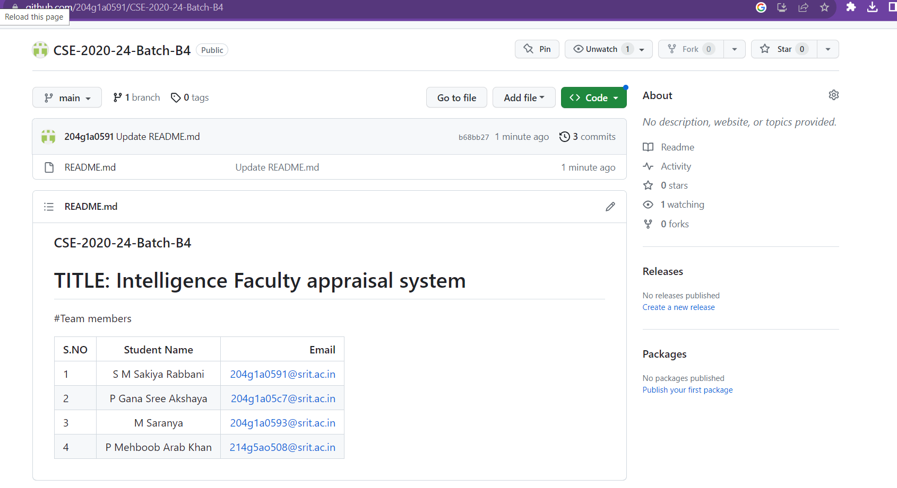
Git Hub Dashboards of each student
https://github.com/204g1a0591/CSE-2020-24-Batch-B4

Slide 11
Any Queries?

